Slide 1

Tokens, Expressions and Control Structures
By Er. Suman Bhandari

Slide 2
Content
Data Types
Primitive data types
Non-primitive/User Define data types
Declaration Statement in Java
Constants in Java
Identifiers in Java
Literal in Java
Type Conversion and Casting

Slide 3
Data Types
There are majorly two types of languages.
First one is Statically typed language where each variable and expression type is already known at compile time. Once a variable is declared to be of a certain data type, it cannot hold values of other data types. Example: C, C++, Java.
The other is Dynamically typed languages. These languages can receive different data types over time. Example: Ruby, Python
Java is a statically-typed programming language. It means, all variables must be declared before its use. That is why we need to declare variable's type and name.

Slide 4
Where is Data Types ?
Data types specify the different sizes and values that can be stored in the variable.
The Java language is rich in its data types.
Different data types allow you to select the type appropriate to the needs of the application.
There are two types of data types in Java:
Primitive data types: The primitive data types include boolean, char, byte, short, int, long, float and double.
Non-primitive data types/User Define Data Types: The non-primitive data types include Classes, Interfaces, and Arrays.

Slide 5
1. Boolean Data Type
Boolean data type represents one bit of information
There are only two possible values: true and false
This data type is used for simple flags that track true/false conditions
Default value is false
Example: boolean one = true

Slide 6
Java program to demonstrate boolean data type
class BooleanDataType{
public static void main(String args[])
{
boolean b = true;
if (b == true)
System.out.println(“I’m Boolean Data Type");
}
}

Slide 7
2. Byte Data Type
Byte data type is an 8-bit signed two's complement integer
Minimum value is -128 (-2^7)
Maximum value is 127 (inclusive)(2^7 -1)
Default value is 0
Byte data type is used to save space in large arrays, mainly in place of integers, since a byte is four times smaller than an integer.
Example: byte a = 100, byte b = -50

Slide 8
3. Short Data Type
Short data type is a 16-bit signed two's complement integer
Minimum value is -32,768 (-2^15)
Maximum value is 32,767 (inclusive) (2^15 -1)
Short data type can also be used to save memory as byte data type. A short is 2 times smaller than an integer
Default value is 0.
Example: short s = 10000, short r = -20000

Slide 9
4. Integer Data Type
Integer types can hold whole numbers such as 123 and −96.
The size of the values that can be stored depends on the integer type that we choose.
Int data type is a 32-bit signed two's complement integer.
Minimum value is - 2,147,483,648 (-2^31)
Maximum value is 2,147,483,647(inclusive) (2^31 -1)
Integer is generally used as the default data type for integral values unless there is a concern about memory.
The default value is 0
Example: int a = 100000, int b = -200000

Slide 10
5. Long Data Type
Long data type is a 64-bit signed two's complement integer
Minimum value is -9,223,372,036,854,775,808(-2^63)
Maximum value is 9,223,372,036,854,775,807 (inclusive)(2^63 -1)
This type is used when a wider range than int is needed
Default value is 0L
Example: long a = 100000L, long b = -200000L

Slide 11
6. Float Data Type
Float data type is a single-precision 32-bit IEEE 754 floating point
Float is mainly used to save memory in large arrays of floating point numbers
Default value is 0.0f
Float data type is never used for precise values such as currency
Example: float f1 = 234.5f

Slide 12
7. Double Data Type
double data type is a double-precision 64-bit IEEE 754 floating point
This data type is generally used as the default data type for decimal values, generally the default choice
Double data type should never be used for precise values such as currency
Default value is 0.0d
Example: double d1 = 123.4

Slide 13
8. Character Data Type
char data type is a single 16-bit Unicode character
Minimum value is '\u0000' (or 0)
Maximum value is '\uffff' (or 65,535 inclusive)
Char data type is used to store any character
Example: char letterA = 'A'

Slide 14
class PrimitiveDataTypeExample {
public static void main(String args[])
{
// declaring character
char a = 'G';
// Integer data type is generally used for numeric values
int i = 89;
// use byte and short if memory is a constraint
byte b = 4;
// this will give error as number is larger than byte range byte b1 = 7888888955;
short s = 56;
// this will give error as number is larger than short range short s1 = 87878787878
double d = 4.355453532;
// for float use 'f' as suffix
float f = 4.7333434f;
System.out.println("char: " + a);
System.out.println("integer: " + i);
System.out.println("byte: " + b);
System.out.println("short: " + s);
System.out.println("float: " + f);
System.out.println("double: " + d);
}
}

Slide 15
Output
char: G
integer: 89
byte: 4
short: 56
float: 4.7333436
double: 4.355453532

Slide 16
User Define/Non-primitive Data Types
Non-primitive types are created by the programmer and is not defined by Java (except for String).
Non-primitive types can be used to call methods to perform certain operations.
A primitive type has always a value, while non-primitive types can be null.
A primitive type starts with a lowercase letter, while non-primitive types starts with an uppercase letter.
The size of a primitive type depends on the data type, while non-primitive types have all the same size.
Examples of non-primitive types are Strings, Arrays, Classes , Interface, etc.

Slide 17
String
Strings are defined as an array of characters.
The difference between a character array and a string is the string is terminated with a special character ‘\0’.
Below is the basic Example for declaring a string in Java programming language.
// Declare String without using new operator
String s = “Ram";
// Declare String using new operator
String s1 = new String(“Ram");

Slide 18
Class
A class is a user-defined blueprint or prototype from which objects are created.
It represents the set of properties or methods that are common to all objects of one type.
In general, class declarations can include these components, in order:
Modifiers : A class can be public or has default access.
Class name: The name should begin with a initial letter (capitalized by convention).
Superclass(if any): The name of the class’s parent (superclass), if any, preceded by the keyword extends. A class can only extend (subclass) one parent.
Interfaces(if any): A comma-separated list of interfaces implemented by the class, if any, preceded by the keyword implements. A class can implement more than one interface.
Body: The class body surrounded by braces, { }.

Slide 19
Object
It is a basic unit of Object-Oriented Programming and represents the real-life entities.
A typical Java program creates many objects, which as you know, interact by invoking methods.
An object consists of :
State : It is represented by attributes of an object. It also reflects the properties of an object.
Behavior : It is represented by methods of an object. It also reflects the response of an object with other objects.
Identity : It gives a unique name to an object and enables one object to interact with other objects.

Slide 20
Interface
Like a class, an interface can have methods and variables, but the methods declared in an interface are by default abstract (only method signature, no body).
Interfaces specify what a class must do and not how. It is the blueprint of the class.
An Interface is about capabilities like a Player may be an interface and any class implementing Player must be able to (or must implement) move(). So it specifies a set of methods that the class has to implement.
If a class implements an interface and does not provide method bodies for all functions specified in the interface, then class must be declared abstract.

Slide 21
Array
An array is a group of like-typed variables that are referred to by a common name.
Arrays in Java work differently than they do in C/C++. Following are some important point about Java arrays.
In Java all arrays are dynamically allocated.(discussed below)
Since arrays are objects in Java, we can find their length using member length. This is different from C/C++ where we find length using sizeof.
A Java array variable can also be declared like other variables with [] after the data type.
The variables in the array are ordered and each have an index beginning from 0.
Java array can be also be used as a static field, a local variable or a method parameter.
The size of an array must be specified by an int value and not long or short.

Slide 22
Declaration Statement in Java
One kind of Java statement is a declaration statement, which is used to declare a variable by specifying its data type and name. Below are some examples of declaration statements.
A variable, in relation to Java programming, is a container that holds values used in a Java program. Instead of defining a value over and over, a variable that has a value attached to it can be defined.

Slide 23
Examples of Declarations in Java
The following three declaration statements declare int, boolean and String variables:
int number; boolean isFinished; String welcomeMessage;
In addition to the data type and name, a declaration statement can initialize the variable with a value:
int number = 10; boolean isFinished = false; String welcomeMessage = "Hello!";
It's also possible to declare more than one variable of the same data type in one declaration statement:
int number, anotherNumber, yetAnotherNumber; boolean isFinished = false, isAlmostFinished = true; String welcomeMessage = "Hello!", farewellMessage;

Slide 24
Constants in Java
A constant is a variable whose value cannot change once it has been assigned. Java doesn't have built-in support for constants.
A constant can make our program more easily read and understood by others. In addition, a constant is cached by the JVM as well as our application, so using a constant can improve performance.
To define a variable as a constant, we just need to add the keyword “final” in front of the variable declaration.

Slide 25
Final Modifier
The final modifier means that the variable's value cannot change. Once the value is assigned, it cannot be reassigned.
Primitive data types (i.e., int, short, long, byte, char, float, double, boolean) can be made unchangeable using the final modifier.
Together, these modifiers create a constant variable.
static final int DAYS_IN_WEEK = 7;
Note that we declared DAYS_IN_WEEK in all caps once we added the final modifier. It's a long-standing practice among Java programmers to define constant variables in all caps, as well as to separate words with underscores.
Java doesn't require this formatting but it makes it easier for anyone reading the code to immediately identify a constant.

Slide 26
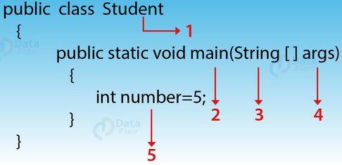
Identifiers in Java
As the name suggests, Identifiers are symbolic names, used for the identification.
To make the most out of the identifiers you choose, make them meaningful and follow the standard Java naming conventions.
Identifiers in Java can be a class name, variable name, constant name, array name, methods name, package names.
Java Identifier example, we have 5 identifiers
Student is the name of the class.
main is the main method.
String is a predefined class name.
args are the string variables.
number is the name of the variable.
In addition, you have to follow some rules before declaring an identifier.

Slide 27
Static Modifier
This allows a variable to be used without first creating an instance of the class; a static class member is associated with the class itself, rather than an object.
All class instances share the same copy of the variable.
This means that another application or main() can easily use it.
For example, class myClass contains a static variable days_in_week:
public class myClass { static int days_in_week = 7; }
Because this variable is static, it can be used elsewhere without explicitly creating a myClass object:
public class myOtherClass { static void main(String[] args) { ); } } System.out.println(myClass.days_in_week

Slide 28
Rules for Identifiers in Java
There are certain rules for declaring an identifier. We need to follow these rules otherwise we will get a compile-time error.
A valid identifier has characters [A-Z],[a-z] or numbers [0-9], $ (dollar sign) and _ (underscore). For example, @dataflair is not a valid identifier, because it contains @ which is a special character.
We can’t declare a variable with space. For example, data flair is invalid.
We can’t start an identifier with a number. For example, 222dataflair is not a valid identifier.
As there is no limit on the length of an identifier but it is 4 – 15 letters only appropriate to use.
It is not recommended to use Reserved words as an identifier. For example, int float=5; is not a valid statement.

Slide 29
Examples of identifiers
Valid identifiers | Invalid identifiers
MyVariable myvariable x i my_Variable _myvariable $myvariable sum_of_array MYVARIABLE dataflair123 | My Variable (it contains a space) 123gkk (it begins with numbers) a+c (plus sign is not an alphanumeric character) variable-2 (the hyphen is not allowed) sum_&_difference (ampersand is not an alphanumeric character) O’Reilly (the apostrophe is not an alphanumeric character)

Slide 30
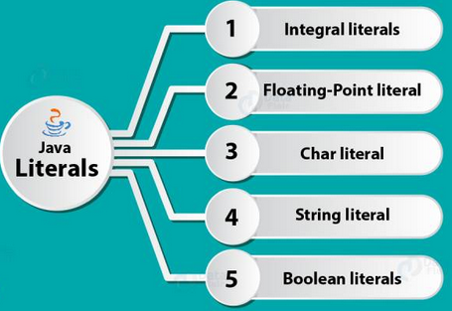
Literal in Java
Any constant value which can be assigned to the variable is called as literal/constant.
A literal is a source code representation of a fixed value.
They are represented directly in the code without any computation.
Literals are number, text, or anything that represent a value.
For example, int x = 100; So, 100 is literal.
There are 5 types of Literals in Java.

Slide 31
1. Integral Literals
We can specify the integer literals in 4 different ways
1. Decimal (Base 10)
Digits from 0-9 are allowed in this form.
Int x = 101;
2. Octal (Base 8)
Digits from 0 – 7 are allowed. It should always have a prefix 0.
int x = 0146;
3. Hexa-Decimal (Base 16)
Digits 0-9 are allowed and also characters from a-f are allowed in this form. Furthermore, both uppercase and lowercase characters can be used, Java provides an exception here.
int x = 0X123Face;
4. Binary
A literal in this type should have a prefix 0b and 0B, from 1.7 one can also specify in binary literals, i.e. 0 and 1.
int x = 0b1111;

Slide 32
2. Floating-Point Literals
Here, datatypes can only be specified in decimal forms and not in octal or hexadecimal form.
In the fractional form, the fractional number contains integer part and fractional part. A dot (.) is used to separate the integer part and fractional part.
Decimal (Base 10)
In this form the allowed digits are 0-9.
Every floating type is a double type and this the reason why we cannot assign it directly to float variable, to escape this situation we use f or F as suffix, and for double we use d or D. for example:
float x = 2.7f;
double x = 54.888d;

Slide 33
3. Character Literal
The character literal is a 16 bit Unicode character where it is enclosed in single quotes. It use primitive data type char.
These are the 4 types of char
i) Single Quote
Java Literal can be specified to a char data type as a single character within a single quote.
char ch = 'a';
ii) Char as Integral
A char literal in Java can specify as integral literal which also represents the Unicode value of a character. Furthermore, an integer can specify in decimal, octal and even hexadecimal type, but the range is 0-65535.
char ch = 062;

Slide 34
iii) Unicode Representation
Char literals can specify in Unicode representation ‘\uxxxx’. Here XXXX represents 4 hexadecimal numbers.
char ch = '\u0061';// Here /u0061 represent a.
iv) Escape Sequence
Escape sequences can also specify as char literal.
char ch = '\n';

Slide 35
4. String Literals
Java String literals are any sequence of characters with a double quote.
String s = "Hello";
They may not contain unescaped newline or linefeed characters.
However, the Java compiler will evaluate compile-time expressions.
Example: String text = "This is a String literal\n" + "which spans not one and not two\n" + "but three lines of text.\n";

Slide 36
5. Boolean Literals
Only two values are allowed for Boolean literals i.e. true and false.
true represents a true Boolean value
false represents a false Boolean value
Example: boolean b = true;

Slide 37
Type Conversion and Casting
Java Type Conversion is the process of assigning a value from one data type to another.
When we need to assign the values of one data type to another and there might be a possibility that the two types are not compatible with each other, then Java does the type casting for us if it can be done automatically, and if not we need to do it explicitly.
There are two types of type casting in Java
Automatic Type Conversion
Explicit Type Conversion

Slide 38
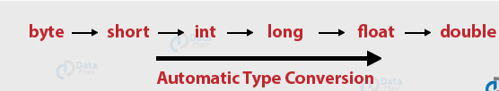
1. Automatic Type Conversion
Automatic or widening type conversion takes place when two data types are automatically converted. This happens when:
The two data types are compatible.
When we want to convert a smaller type to the larger type size.

Slide 39
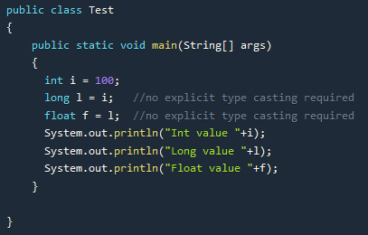
Example of Automatic Type Conversion
Output
Int value 100
Long value 100
Float value 100.0

Slide 40

2. Explicit Type Conversion
Explicit or narrowing casting in Java is done manually.
When we want to convert a larger type to the smaller type size then we use explicit type casting.

Slide 41
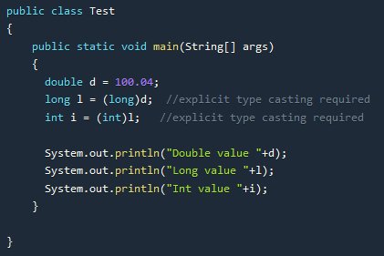
Example of Explicit Type Conversion
Output
Double value 100.04
Long value 100
Int value 100

Slide 42
Variables in Java
A variable is a name given to a memory location. It is the basic unit of storage in a program.
The value stored in a variable can be changed during program execution.
A variable is only a name given to a memory location, all the operations done on the variable effects that memory location.
In Java, all the variables must be declared before use.

Slide 43
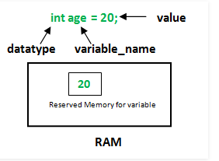
How to declare variables?
We can declare variables in java as follows:
datatype: Type of data that can be stored in this variable.
variable_name: Name given to the variable.
value: It is the initial value stored in the variable.

Slide 44
Examples:
float simpleInterest; //Declaring float variable
int time = 10, speed = 20; //Declaring and Initializing integer variable
char var = 'h'; // Declaring and Initializing character variable

Slide 45
Types of Variables
There are three types of variables in Java:
Local Variables
Instance Variables
Static Variables

Slide 46
1. Local Variables:
A variable defined within a block or method or constructor is called local variable.
These variable are created when the block in entered or the function is called and destroyed after exiting from the block or when the call returns from the function.
The scope of these variables exists only within the block in which the variable is declared. i.e. we can access these variable only within that block.
Initialisation of Local Variable is Mandatory.

Slide 47
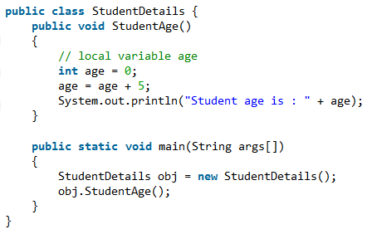
Program of Local Variables
Output
Student age is : 5
In the above program, the variable age is a local variable to the function StudentAge(). If we use the variable age outside StudentAge() function, the compiler will produce an error as shown in below program.

Slide 48
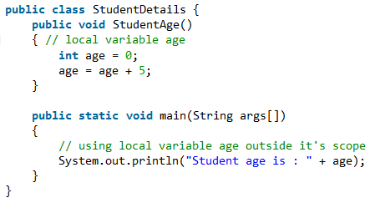
Compilation Error in java code :-
prog.java:12: error: cannot find symbol
System.out.println("Student age is : " + age);
^
symbol: variable age
location: class StudentDetails
1 error

Slide 49
2. Instance Variables:
Instance variables are non-static variables and are declared in a class outside any method, constructor or block.
As instance variables are declared in a class, these variables are created when an object of the class is created and destroyed when the object is destroyed.
Unlike local variables, we may use access specifiers for instance variables. If we do not specify any access specifier then the default access specifier will be used.
Initialisation of Instance Variable is not Mandatory. Its default value is 0
Instance Variable can be accessed only by creating objects.

Slide 50
Program of Instance Variables
import java.io.*;
class Marks {
// These variables are instance variables.
// These variables are in a class
// and are not inside any function
int engMarks;
}
class MarksDemo {
public static void main(String args[])
{
// first object
Marks obj1 = new Marks();
obj1.engMarks = 50;
// second object
Marks obj2 = new Marks();
obj2.engMarks = 80;
// displaying marks for first object
System.out.println("Marks for first object:");
System.out.println(obj1.engMarks);
// displaying marks for second object
System.out.println("Marks for second object:");
System.out.println(obj2.engMarks); }
}
Output:
Marks for first object:
50
Marks for second object:
80
in this program the variables, engMarks is instance variables.

Slide 51
3. Static Variables
We declare static keyword in Java same as the instance variables, i.e. outside any object, block, or constructor, the difference in the syntax is that it uses the keyword static with it.
It can also have as many copies which means it can be used for many classes.
They are initialized at the beginning of program execution and destroyed when the program ends.

Slide 52
Program of Static Variables
import java.io.*;
class Emp {
// static variable salary
public static double salary;
public static String name = "Hari";
}
public class EmpDemo{
public static void main(String args[]) {
//accessing static variable without object
Emp.salary = 1000;
System.out.println(Emp.name + "'s average salary:" + Emp.salary)
}
}
Output
Hari's average salary:1000.0

Slide 53
Default Variable Initializations
In Java, when variable is declared as field (static or instance variable inside class), then initialization of that variable is optional.
In other words, while declaring field variable you may or may not initialize to its value.
if you are not, then Java runtime assigns default value to it. and when you try to access the variable you get the default value of that variable.
Following table shows variables types and their default values

Slide 54
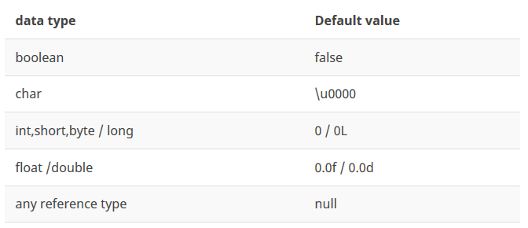
Here, char primitive default value is \u0000, which means blank/space character.
When you have the variable of reference types then it gets the null as default value.
In following code listing, variables are declared as instance fields. Same is applied for static fields too.

Slide 55
class DefaultValue {
// here all integers will get value as 0
byte b;
short s;
int i;
long l;
// here floating points initialized to value as 0.0
float f;
double d;
// this characters is initialized to blank i.e \u0000
char c;
// Boolean is initialized to false
boolean e;
// this will get the value as null
DefaultValue defaultValue;
String string;
}
But, this is not the case with local variables or block variables.
When you declare any local/block variable, they didn’t get the default values. They must assigned some value before accessing it other wise compiler will throw an error.

Slide 56
Command Line arguments in Java
Command line argument is mainly used to control your program from outside.
When a command is sent to the JVM, it wraps them and sends them to args .
The args array here actually wraps the arguments by checking the length of the argument using args.length.
To access the command-line argument inside a java program is quite easy, they are stored as string in String array passed to the args parameter of main() method.

Slide 57
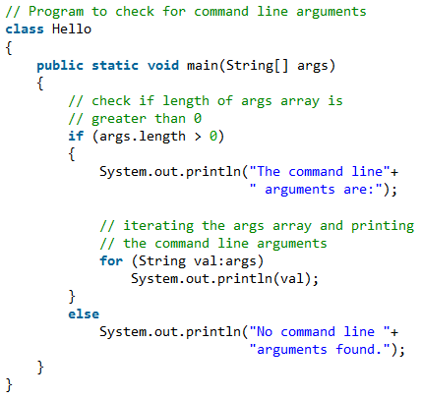
Example of Command Line arguments
Output
javac Hello.java
java Hello
No command line arguments found
Java Hello Welcome to Java Class
The command line arguments are:
Welcome
To
Java
Class

Slide 58
Garbage Collection
Languages like C or C++ that do not offer automatic garbage collection.
Java garbage collection is the process by which Java programs perform automatic memory management.
Java programs compile to bytecode that can be run on a Java Virtual Machine.
When Java programs run on the JVM, objects are created on the heap, which is a portion of memory dedicated to the program.
Eventually, some objects will no longer be needed. The garbage collector finds these unused objects and deletes them to free up memory.

Slide 59
Garbage Collection
Garbage collection revolves around making sure that the heap has as much free space as possible.
Heap is that part of memory where Java objects live, and it's the one and only part of memory that is in any way involved in the garbage collection process.
When the garbage collector runs, its purpose is to find and delete objects that cannot be reached.
If no more memory is available for the heap, then the new operator throws an OutOfMemoryException

Slide 60
Disadvantage of Garbage Collection
We can do nothing to improve GC , but only improve out program
Less control over scheduling of CPU time.

Slide 61
When Does Garbage Collector Run
The garbage collector is under the control of the JVM. The JVM decides when to run the garbage collector.
Objects that are referenced are said to be alive. Unreferenced objects are considered dead(garbage).
From within your Java program you can ask the JVM to run the garbage collector, but there are no guarantees, under any circumstances, that the JVM will comply.
The JVM will typically run the garbage collector when it senses that memory is running low.

Slide 62
Detecting Garbage Objects
REFERENCE-COUNTING COLLECTORS: When the object is created the reference count of object is set to one. When you reference the object REFERENCE-COUNTING is incremented by
When reference to an object goes out of scope ,the REFERENCE-COUNTING is decremented
Object that have REFERENCE-COUNTING zero (not referenced) is a garbage object.
ADVANTAGES:
Can run in small chunks of time.
Suitable for real time environments

Slide 63
Operators in Java
Operators are special symbols (characters) that carry out operations on operands (variables and values).
For example, + is an operator that performs addition.
Assignment Operator
Arithmetic Operator
Relational Operator
Logical Operator
Ternary/Conditional Operator
Bitwise Operator
Shift Operator
Increment and Decrement Operators

Slide 64
1. Arithmetic Operators
Java arithmetic operator takes numerical values as operands, operates on them, and returns a single numerical value.
Java Arithmetic operators are used for simple mathematic operations, they are
Addition (+)
Subtraction (-)
Multiplication (*)
Division (/)
Modulus (%)

Slide 65
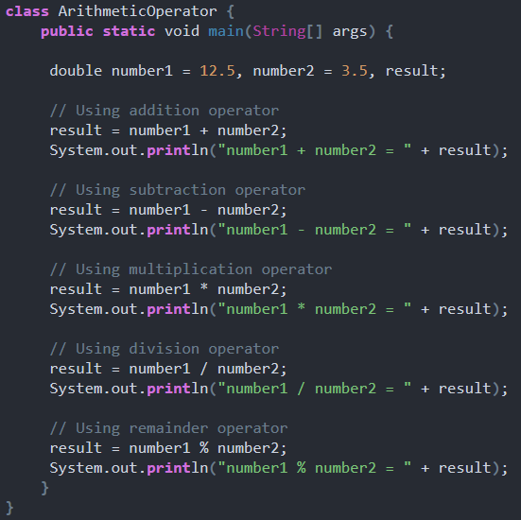
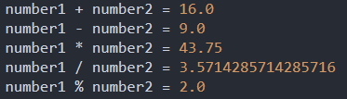
When you run the program, the output will be

Slide 66
2. Bitwise Operators
Bitwise operators are used to perform operations on single bitwise values.
First, it converts the numerical value to its binary representation and then it performs the necessary operation and gives the result.
Operator Name | Description
Bitwise AND operator (&) | The & operator compares corresponding bits of two operands. If both bits are 1, it gives 1 else 0.
Bitwise OR operator (|) | The | operator compares corresponding bits of two operands. If either of the bits is 1, it gives 1 else 0.
Bitwise XOR operator (^) | The ^ operator compares corresponding bits of two operands. If corresponding bits are different, it gives 1 else 0.
Bitwise Complement operator (~) | The ~ operator inverts the bit pattern. It makes every 0 to 1 and every 1 to 0.

Slide 67
public class BitwiseOperators {
public static void main(String[] args) {
int a = 5;
int b = 7;
// bitwise and 0101 & 0111=0101 = 5
System.out.println("a&b = " + (a & b));
// bitwise or 0101 | 0111=0111 = 7
System.out.println("a|b = " + (a | b));
// bitwise xor 0101 ^ 0111=0010 = 2
System.out.println("a^b = " + (a ^ b));
// bitwise and ~0101=1010 will give 2's complement of 1010 = -6
System.out.println("~a = " + ~a);
// can also be combined with assignment operator to provide shorthand assignment
// a=a&b
a &= b;
System.out.println("a= " + a);
}
}
Output
a&b = 5
a|b = 7
a^b = 2
~a = -6
a= 5

Slide 68
3. Relational Operators
The equality and relational operators determines the relationship between two operands.
It checks if an operand is greater than, less than, equal to, not equal to and so on.
Depending on the relationship, it results to either true or false.
Operator Name | Example | Description
== (equals to) | x==y | True if x equals y, otherwise false
!= (not equal to) | x!=y | True if x is not equal to y, otherwise false
< (less than) | x<y | True if x is less than y, otherwise false
> (greater than) | x > y | True if x is greater than y, otherwise false
>= (greater than or equal to) | x>=y | True if x is greater than or equal to y, otherwise false
<= (less than or equal to) | x<=y | True if x is less than or equal to y, otherwise false

Slide 69
class RelationalOperator {
public static void main(String[] args) {
int number1 = 5, number2 = 6;
if (number1 > number2){
System.out.println("number1 is greater than number2.");
}
else{
System.out.println("number2 is greater than number1.");
}
}
}
Output
number2 is greater than number1.

Slide 70
4. Logical Operators
The logical operators || (conditional-OR) and && (conditional-AND) operates on boolean expressions.
Operator | Description | Example
|| | conditional-OR; true if either of the boolean expression is true | false || true is evaluated to true
&& | conditional-AND; true if all boolean expressions are true | false && true is evaluated to false

Slide 71
class LogicalOperator {
public static void main(String[] args) {
int number1 = 1, number2 = 2, number3 = 9;
boolean result;
// At least one expression needs to be true for result to be true
result = (number1 > number2) || (number3 > number1);
// result will be true because (number1 > number2) is true
System.out.println(result);
// All expression must be true from result to be true
result = (number1 > number2) && (number3 > number1);
// result will be false because (number3 > number1) is false
System.out.println(result);
}
}
Output
true
false

Slide 72
5. Assignment Operator
An assignment operator assigns a value to the left operand based on the value of its right operand with the help of equals = sign. Thus, x = y assigns the value of y into x.
Operator Name | Description
+= | To add the right and left operator and then assigning the result to the left operator
-= | To subtract the two operands on left and right and then assign the value to the left operand
*= | To multiply the two operands on left and right and then assign the value to the left operand
/= | To divide the two operands on left and right and then assign the value to the left operand
^= | To raise the value of left operand to the power of right operator
%= | To apply modulus operator

Slide 73
public class AssignmentOperator {
// Java program to illustrate assignment operators
public static void main(String[] args)
{
int operand1 = 20, operand2 = 10, operand3 = 10, operand4 = 4;
// simple assignment operator
operand3 = operand2;
System.out.println("Value of operand3 = " + operand3);
// This following statement would throw an exception as value of right operand must be initialised before an assignment, and the program would not compile.
operand1 = operand1 + 1;
operand2 = operand2 - 1;
operand3 = operand3 * 2;
operand4 = operand4 / 2;
System.out.println("operand1,operand2,operand3,operand4 = "+ operand1 + "," + operand2 + "," + operand3 + "," +operand4);
operand1 = operand1 - 1;
operand2 = operand2 + 1;
operand3 = operand3 / 2;
operand4 = operand4 * 2;
// shorthand assignment operator
operand1 += 1;
operand2 -= 1;
operand3 *= 2;
operand4 /= 2;
System.out.println("operand1,operand2,operand3,operand4 (using shorthand operators)= " +operand1 + "," + operand2 + "," + operand3 + "," + operand4);
}
}

Slide 74
6. Conditional Operators
The Java Conditional Operator selects one of two expressions for evaluation, which is based on the value of the first operands.
It is also called ternary operator because it takes three arguments.
The goal of the operator is to decide; which value should be assigned to the variable.
The operator is written as:
variable x = (expression)? value if true: value if false

Slide 75
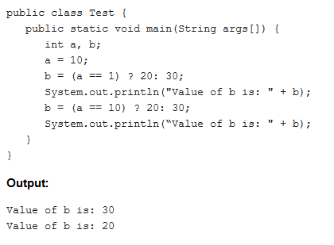

Slide 76
7. Shift Operators
A shift operator performs bit manipulation on data by shifting the bits of its first operand right or left.
Operator Name | Description
<< (left shift operator) | It shifts x in binary representation y bits to the left, shifting in zeros from the right.
>> ( right shift operator) | It shifts x in binary representation y bits to the right, discarding bits shifted off.
>>> (unsigned right shift operator) | It shifts x in binary representation y bits to the right, discarding bits shifted off, and shifting in zeros from the left.

Slide 77

public class ShiftOperator {
public static void main(String[] args){
int a = 0x0005;
int b = -10;
// left shift operator
// 0000 0101 << 2 = 0001 0100
System.out.println("a << 2 = " + (a << 2));
// right shift operator
// 0000 0101 >> 2 =0000 0001
// similar to 5 / (2 ^ 2)
System.out.println("a >> 2 = " + (a >> 2));
// unsigned right shift operator
System.out.println("b >>> 2 = "+ (b >>> 2));
}
}

Slide 78
8. Increment and Decrement Operators
There are 2 Increment or decrement operators -> ++ and --.
These two operators are unique in that they can be written both before the operand they are applied to, called prefix increment/decrement, or after, called postfix increment/decrement.
The meaning is different in each case.

Slide 79
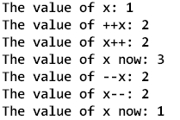
public class IncrementDecrement {
public static void main(String[] args) {
int x = 1;
System.out.println("The value of x: " + x);
System.out.println("The value of ++x: " + ++x);
System.out.println("The value of x++: " + x++);
System.out.println("The value of x now: " + x);
System.out.println("The value of --x: " + --x);
System.out.println("The value of x--: " + x--);
System.out.println("The value of x now: " + x);
}
}
Output

Slide 80
Control Statements in Java
A programming language uses control statements to control the flow of execution of program based on certain conditions.
These are used to cause the flow of execution to advance and branch based on changes to the state of a program.
A control statement works as a determiner for deciding the next task of the other statements whether to execute or not.
These statements allow you to control the flow of your program’s execution based upon conditions known only during run time.

Slide 81
There are three kinds of control structures:
Conditional Branches, which we use for choosing between two or more paths. There are three types in Java: if/else/else if and switch.
Loops that are used to iterate through multiple values/objects and repeatedly run specific code blocks. The basic loop types in Java are for, while and do while.
Branching Statements, which are used to alter the flow of control in loops. Such as: break, continue and return.

Slide 82
if Statement
Simple if statement is the basic of decision-making statements in Java. It decides if certain amount of code should be executed based on the condition.
Syntax
if (condition) {
Statemen 1; //if condition becomes true then this will be executed
}
Statement 2; //this will be executed irrespective of condition becomes true or false

Slide 83
class ifTest {
public static void main(String args[]) {
int x = 5;
if (x > 10)
System.out.println("Inside If");
System.out.println("After if statement");
}
}
Output:
After if statement

Slide 84
if…else Statement
In if…else statement, if condition is true then statements in if block will be executed but if it comes out as false then else block will be executed.
Syntex
if (condition) {
Statemen 1; //if condition becomes true then this will be executed
} else {
Ststement 2:

Slide 85
class ifelseTest {
public static void main(String args[]) {
int x = 9;
if (x > 10){
System.out.println("i is greater than 10");
}else {
System.out.println("i is less than 10");
}
System.out.println("After if else statement");
}
}
Output
i is less than 10
After if else statement

Slide 86
Nested if statement
Nested if statement is if inside an if block. It is same as normal if…else statement but they are written inside another if…else statement.
Syntax:
if (condition1) {
Statemen 1; //executed when condition1 is true
if (condition2) {
Statement 2; //executed when condition2 is true
} else {
Statement 3; //executed when condition2 is false
}
}

Slide 87
class nestedifTest {
public static void main(String args[]) {
int x = 25;
if (x > 10) {
if (x%2==0)
System.out.println("i is greater than 10 and even number");
else
System.out.println("i is greater than 10 and odd number");
} else {
System.out.println("i is less than 10");
}
System.out.println("After nested if statement");
}
}
Output:
i is greater than 10 and odd number After nested if statement

Slide 88
if...else if…else statement
if…else if statements will be used when we need to compare the value with more than 2 conditions.
They are executed from top to bottom approach.
As soon as the code finds the matching condition, that block will be executed.
But if no condition is matching then the last else statement will be executed.
Syntax:
if (condition2) {
Statemen 1; //if condition1 becomes true then this will be executed
} else if (condition2) {
Statement 2; // if condition2 becomes true then this will be executed
} . . else {
Statement 3; //executed when no matching condition found
}

Slide 89
class ifelseifTest {
public static void main(String args[]) {
int x = 2;
if (x > 10) {
System.out.println("i is greater than 10");
} else if (x <10)
System.out.println("i is less than 10");
} else {
System.out.println("i is 10");
}
System.out.println("After if else if ladder statement");
}
}
Output:
i is less than 10
After if else if ladder statement

Slide 90
Switch Statement
Java switch statement compares the value and executes one of the case blocks based on the condition. It is same as if…else if.
case value must be of the same type as expression used in switch statement
case value must be a constant or literal. It doesn’t allow variables
case values should be unique. If it is duplicate, then program will give compile time error
switch (variable/expression) {
case value1:
// statements
break;
case value2:
// statements
break;
.. .. ...
default:
// statements
}

Slide 91
class Day {
public static void main(String[] args) {
int week = 4;
String day;
switch (week) {
case 1:
day = "Sunday";
break;
case 2:
day = "Monday";
break;
case 3:
day = "Tuesday";
break;
case 4:
day = "Wednesday";
break;
default:
day = "Invalid day";
break;
}
System.out.println(day);
}
}
Output:
Wednesday

Slide 92
Looping Statements
Looping statements are the statements which executes a block of code repeatedly until some condition meet to the criteria.
Loops can be considered as repeating if statements.
There are 4 types of loops available in Java.
While
Do…while
For
For-Each

Slide 93
1. While Loop
While loops are simplest kind of loop. It checks and evaluates the condition and if it is true then executes the body of loop.
This is repeated until the condition becomes false.
Condition in while loop must be given as a Boolean expression.
If int or string is used instead, compile will give the error.
Syntax:
while (condition) {
statement1;
}

Slide 94
class whileLoopTest {
public static void main(String args[]){
int j = 1;
while (j <= 10) {
System.out.println(j);
j = j+2;
}
}
}
Output:
1
3
5
7
9

Slide 95
2. Do…while Loop
Do…while works same as while loop. It has only one difference that in do…while, condition is checked after the execution of the loop body.
That is why this loop is considered as exit control loop.
In do…while loop, body of loop will be executed at least once before checking the condition
Syntax:
do{
statement1;
}while(condition);

Slide 96
class dowhileLoopTest {
public static void main(String args[]) {
int j = 10;
do {
System.out.println(j);
j = j+1;
} while (j <= 10)
}
}
Output:
10

Slide 97
3. For Loop
It is the most common and widely used loop in Java.
It is the easiest way to construct a loop structure in code as initialization of a variable, a condition and increment/decrement are declared only in a single line of code.
It is easy to debug structure in Java.
Syntax:
for (initialization; condition; increment/decrement) {
statement;
}

Slide 98
class forLoopTest {
public static void main(String args[]) {
for (int j = 1; j <= 5; j++)
System.out.println(j);
}
}
Output:
1
2
3
4
5

Slide 99
4. For-Each Loop
For-Each loop is used to traverse through elements in an array.
It is easier to use because we don’t have to increment the value.
It returns the elements from the array or collection one by one.
class foreachDemo{
public static void main(String args[]){
int a[] = {10,15,20,25,30};
for (int i : a) {
System.out.println(i);
}
}
}
Output:
10
15
20
25
30

Slide 100
Branching Statements
Branching statements jump from one statement to another and transfer the execution flow.
It is also called jumping statement.
There are 3 branching statements in Java.
Break
Continue
Return

Slide 101
1. Break
Break statement is used to terminate the execution and bypass the remaining code in loop.
It is mostly used in loop to stop the execution and comes out of loop.
When there are nested loops then break will terminate the innermost loop.

Slide 102
class breakTest {
public static void main(String args[]) {
for (int j = 0; j < 5; j++) {
// come out of loop when i is 4.
if (j == 4)
break;
System.out.println(j);
}
System.out.println("After loop");
}
}
Output:
0
1
2
3
4
After loop

Slide 103
2. Continue
Continue statement works same as break but the difference is it only comes out of loop for that iteration and continue to execute the code for next iterations.
So it only bypasses the current iteration.
class continueTest {
public static void main(String args[]) {
for (int j = 0; j < 10; j++) {
// If the number is odd then bypass and continue with next value
if (j%2 != 0)
continue;
// only even numbers will be printed
System.out.print(j + " ");
}
}
}
Output:
0 2 4 6 8

Slide 104
3. Return
Return statement is used to transfer the control back to calling method.
Compiler will always bypass any sentences after return statement.
So, it must be at the end of any method.
They can also return a value to the calling method.
Here method getwebURL() returns the current URL to the caller method.

Slide 105
public String getwebURL() {
String vURL= null;
try {
vURL= driver.getCurrentUrl();
} catch(Exception e) {
System.out.println("Exception occured while getting the current url : "+e.getStackTrace());
}
return vURL;
}

